Slide 1

Lecture 7: IT in health
Hoger Mahmud

Slide 2



Lecture outline
What is health
What is eHealth
Technical scope of eHealth
Examples of eHealth systems
Software and hardware used eHealth
Benefits of eHealth
2

Slide 3
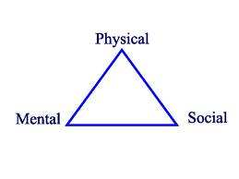
What is health
Physical health deals with
the body’s ability to function
Mental heath deals with how
we think, feel and cope with daily life
Social Health deals with the way
we react with people within our environment
3

Slide 4
What is ehealth
Healthcare which is supported by electronic processes
Other terms:
Healthcare informatics or Health Information Technology (HIT)
Medical Information Systems (MIS)
Biomedical informatics (also includes Bioinformatics: gene sequencing etc.)
4

Slide 5
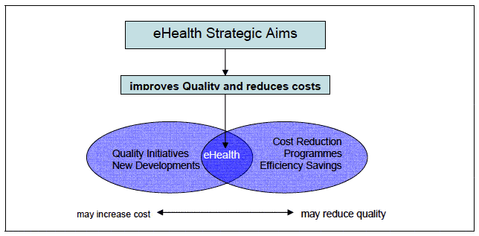
e-health objective
5

Slide 6
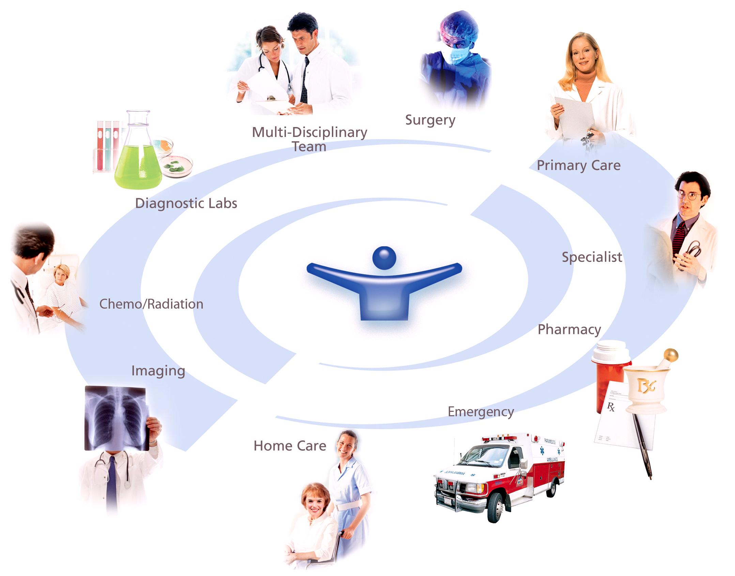
e-health area of service
6

Slide 7
Scope of ehealth
1. Clinical information systems
a- Specialised tools for health professionals within care institutions
b- Tools for primary care and/or for outside the care institutions
2. Telemedicine systems and services
3. Regional/national health information networks
including electronic health record systems and associated services
4. Secondary usage / non-clinical systems
a- Systems for medical education, research, public health
b- Health education and health promotion of patients/citizens
7

Slide 8
Technical building blocks of ehealth
The Connectivity (networks)
Security and en encryption
Authentication
Databases (certified sources and others)‏
XML applications
Naming systems/ defining terms, codes, .
Sources/portals
8

Slide 9
Examples of ehealth systems
Electronic Medical Records: easy communication of patient data between different healthcare professionals (GPs, specialists, care team, pharmacy
Telemedicine: do not require a patient and specialist in same physical location.
Decision support systems in healthcare
Data can be analysed to provide alerts, reminders and real-time decision aids
Citizen-oriented Information Provision: for both healthy individuals and patients
9

Slide 10
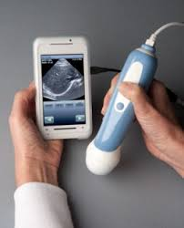
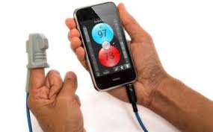
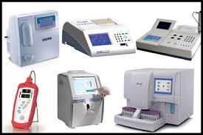
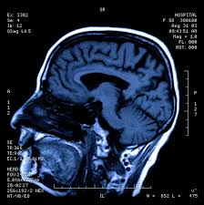
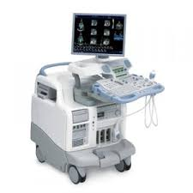
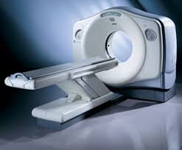
Hardware examples used in eHealth
Ultrasound
Blood pressure reader
Test analyser
CT Scan
x-ray
Others
10

Slide 11
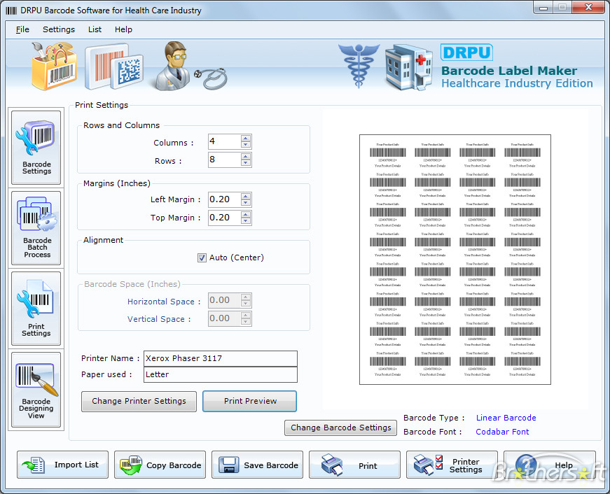
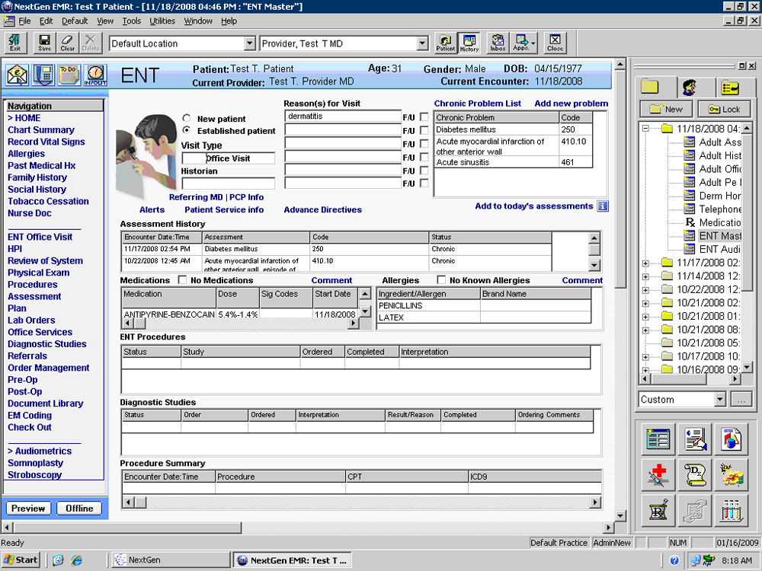



ehealth software examples
11

Slide 12
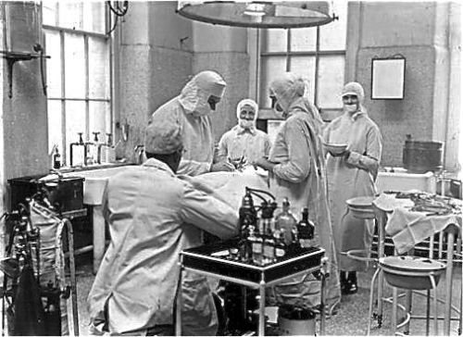
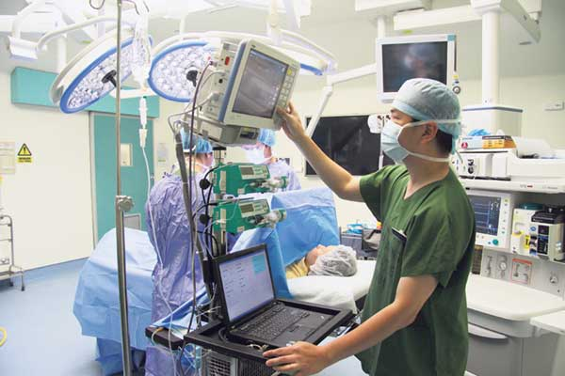
The change IT has brought to health care
Without IT
With IT
12

Slide 13
Benefits of ehealth care
Reduced record keeping expenses
More accurate data
No poor handwriting problems
Automated sharing among patients and provider
Empower the patient to manage their own health via Internet information and decision support tools
Reduced office visits to get results
Avoidance of duplicating tests
Automatic summarisation/graphical displays of context-relevant information to the physician
Decreased risk of malpractice suits
13

Slide 14

Thank you
?

